Slide 1

Phishing Awareness Training
Empowering you to recognize and prevent cyber threats

Slide 2

Phishing Awareness Training
Module 1: What Is Phishing?
Phishing is a deceptive cyber-attack where malicious actors impersonate trusted entities to trick you into revealing sensitive data or downloading malware.
Understanding phishing is your first line of defense. This training will equip you with the knowledge to spot and avoid these pervasive threats.

Slide 3







Module 2: Common Phishing Techniques
Email Phishing
Spear Phishing
Broad, generic messages sent to many, demanding urgent action (e.g., "Verify your account now!").
Highly personalized attacks aimed at specific individuals or roles (e.g., Finance, HR), leveraging known details.
Clone Phishing
Whaling
Replicated legitimate emails with subtle alterations, like swapped malicious links or infected attachments.
Targets high-profile executives (CEOs, CFOs) with sophisticated content designed to mimic critical business communications.

Slide 4
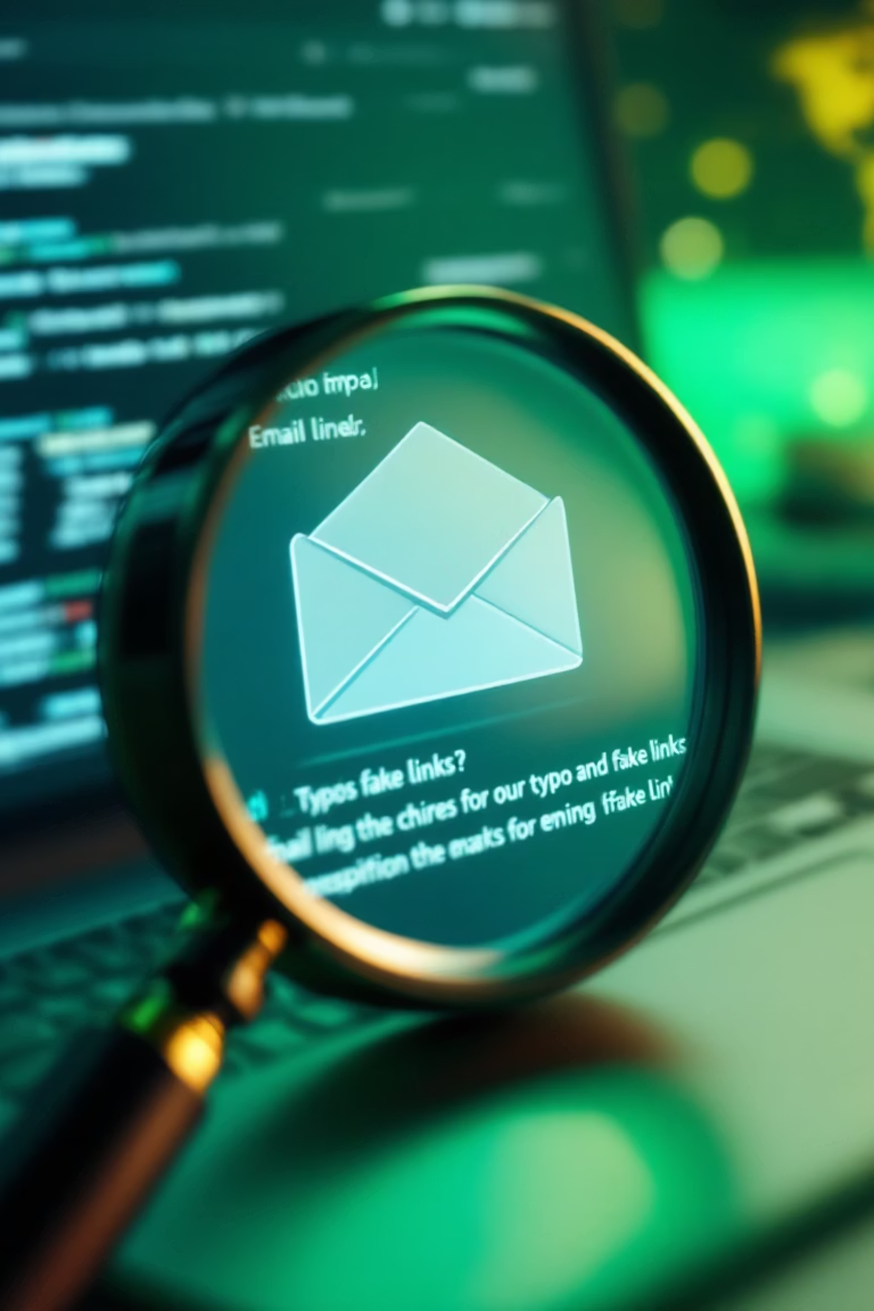
Module 3: Spotting Phishing Emails
1
Sender Address
Look for mismatched domains (e.g., "support@yourbank-secure.com" instead of "@yourbank.com") or slight misspellings.
2
Greetings & Tone
Be wary of generic greetings like "Dear Customer" or an overly urgent, threatening, or overly tempting tone.
3
Links & Attachments
Hover over links to reveal the actual URL (don't click!). Never open unexpected attachments, especially .zip, .exe, or .js files.
4
Spelling & Grammar
Frequent typos, awkward phrasing, or unusual grammatical structures are red flags for phishing attempts.
5
Calls to Action
Phishing emails often demand immediate action, create a false sense of urgency, or threaten account closure.

Slide 5


Module 4: Spotting Fake Websites
Phishing attacks often direct you to convincing, yet fake, websites. Know what to look for to avoid falling victim.
Indicator
Legitimate Site
Phishing Site
URL structure
https://www.company.com
http://company.verify-secure.com
SSL certificate
Padlock icon, valid certificate details
No padlock or mismatched certificate
Design consistency
Company branding, polished UI
Low-resolution logos, odd color schemes
Contact information
Real phone numbers, support email
Missing or bogus contact details

Slide 6
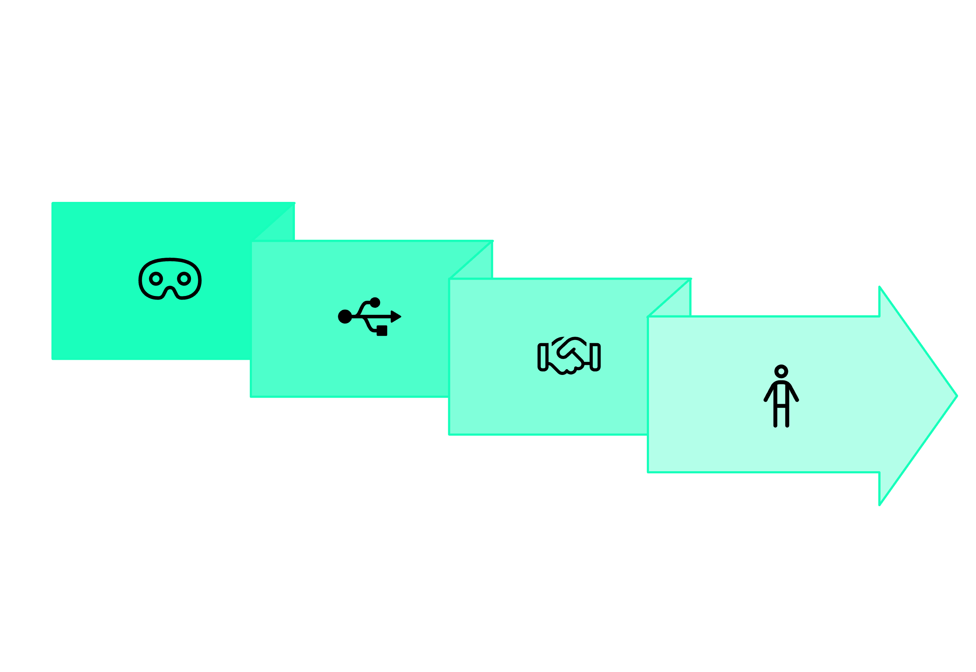





Module 5: Social Engineering Tactics
Phishing often leverages social engineering, manipulating you psychologically to gain access or information.
Baiting
Impersonation
Pretexting
Quid Pro Quo

Slide 7


Module 6: Best Practices to Stay Safe
1
2
3
Verify Before You Trust
Never Click Unverified Links
Keep Software Updated
If an email seems suspicious, call the sender directly using a known, official number, not one from the email.
Always type URLs manually or use bookmarked pages. Directly clicking links can lead to compromised sites.
Regularly apply security patches and keep antivirus software updated to protect against known vulnerabilities.
4
5
Use Multi-Factor Authentication
Report Suspicious Activity
Enable MFA on all accounts. It adds an essential second layer of security beyond just your password.
Forward any suspected phishing attempts or suspicious activity to your company's IT security team immediately.

Slide 8



Module 7: Real-World Case Studies
Case Study 1: The Fake Invoice
Case Study 2: Executive Impersonation
An employee received an email impersonating a vendor with a PDF invoice link. Clicking it installed malware, compromising financial systems.
A fraudster spoofed the CEO’s email, requesting an urgent wire transfer. The finance team, believing it genuine, transferred $50,000 before noticing a subtle domain mismatch.
Key takeaway: Always verify unexpected invoices via a known, official phone number, not through contact details in the suspicious email.
Key takeaway: Implement dual-approval processes for all high-value financial transactions, even those from senior management.

Slide 9



Module 10: Next Steps & Resources
Your proactive approach is key to our collective security. Continue to build your cybersecurity literacy with these resources:
Enroll in Quarterly Simulated Phishing Campaigns
Bookmark Official Security Policies
Explore Advanced Cybersecurity Modules
Keep readily accessible links to your organization's cybersecurity policies and incident response procedures.
Deepen your knowledge with training on password management, secure remote work setups, and data handling best practices.
Participate in regular simulations to test your awareness and reinforce learning in a safe environment.
Building a Resilient Cybersecurity Culture
Phishing awareness is a foundational step. By staying informed and vigilant, you contribute significantly to a stronger, more secure environment for everyone.

Slide 10







Thank You!
Your vigilance strengthens our collective security.
Feedback
Help us improve by sharing your thoughts on this training.
Questions?
Feel free to reach out for further clarification.
Collaboration
Let's work together to build a secure environment.
Presented by:
Prashant Bhandari

